Slide 1
ENGINEERING LICENSURE
A PATH OF OPPORTUNITY
Notes:
Oklahoma State Board of Licensure for Professional Engineers and Land Surveyors
National Council of Examiners for Engineering and Surveying

Slide 2
What is an engineer??
An engineer is an individual who uses his/her mathematical and engineering science skills to produce products and systems that are useful to mankind.
Notes:
Everything you do from the time you wake up involves an engineer – alarm clock, water for shower, toasting your bagel, driving, streets, phone, i-pad, etc.

Slide 3
WHY DO WE HAVE LICENSURE?
In order to safeguard life, health, and property, and to promote the public welfare.
Notes:
All professions require licensure to practice – medical doctor, lawyer, accountants, even to cut your hair requires licensure.
Would you go to a doctor or lawyer that wasn’t licensed?
Not all of engineers will need to be licensed. If you work for private industry, you won’t be signing and sealing documents, but you never know where your career will take you.

Slide 4

Five Reasons to Get Licensed
1. Prestige
2. Career Development
3. Authority
4. Flexibility
Money
Notes:
Prestige – respected by the public and their peers in the engineering community
Career Development – Enhances your stature – shows commitment to the profession
Authority – only P.E.’s can sign and seal engineering drawings and only P.E.’s can be in responsible charge of a firm in private practice
Flexibility – Probably most important – gives you more career options
Money – studies show that you will make more $ during your career

Slide 5
VIDEO
Notes:
Licensure important for individual and firm / ****** $5,000 bonus ******** / Promotions go to P.E.’s
Time to study by firm / Excitement of title EIT – even more so with title P.E.

Slide 6
Path to Licensure
Pass the Fundamentals of Engineering (FE) examination
Graduate from an ABET program with a degree in engineering
Obtain 4 years of progressive engineering experience following the date of your degree
Pass the Principles and Practice of Engineering (PE) examination
Notes:
These are the 4 steps to licensure – our main focus today – THE FE EXAM and why we strongly encourage that you take it as you are finishing school.
More important than ever to be marketable.
Lots of competition for jobs today – if you are competing for a job and both are equal – being a licensed P.E. might give you the edge to get the job.
Engineering Technology Degree requires six (6) years of experience before becoming a P.E. (Master’s degree counts as one year experience)

Slide 7
The path to licensure begins with the FE: the Fundamentals of Engineering Examination

Slide 8
Why take the FE Exam?
To pursue PE license
Professional Career Advancement
  More mobility
  More earning power
  More flexibility in career prospects
YOU NEVER KNOW WHEN
YOU WILL NEED IT.
Notes:
We went over most of these in an earlier slide. Main point of my talk – YOU NEVER KNOW WHEN YOU WILL NEED IT / next slide – GOOD FOREVER!
Many career changes, so one important step out of the way if you take the FE exam when you have the best chance of passing it.
You may think you know your career plans, but things change. Bill recently processed an application from someone who passed the FE in 1976, but didn’t take the P.E. Exam until 2009. Just think about trying to pass an exam over things you had studied 30 years ago!

Slide 9
Once you pass the FE, it is good forever and is accepted in all 50 states and numerous U.S. territories*.
Notes:
GOOD FOREVER AND GOOD IN ANY STATE! Some states have restrictions.
Can’t be an EI in MO unless you graduate from a MO university. Experience still counts towards P.E., just cant be certified EI.
FE does expire in IL, but only for those who took FE in IL. Oregon has strange rules about FE/EI.
Doesn’t matter what discipline or what your score (don’t know score – it is Pass/Fail)
If you fail the exam, you are provided with a diagnostic report of strengths and weaknesses to help you prepare for next exam.

Slide 10
FE EXAM
You may take the exam anytime, but pass rates are the highest during your last two semesters in school .
Notes:
To have a solid basis of test materials, best to wait until last 2 semesters.

Slide 11
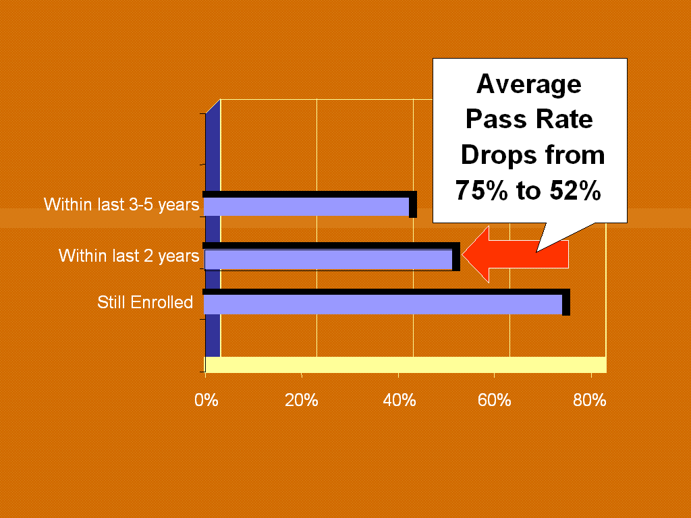
Notes:
Easier to pass while the material is fresh / Video mentioned that people change jobs 6-7 times, recent study says 10.

Slide 12
2015 National FE Pass Rates
Exam | Volume | Passs Rate
Chemical | 1377 | 76%
Civil | 7873 | 70%
Electrical and Computer | 1991 | 75%
Environmental | 1023 | 74%
Industrial | 353 | 64%
Mechanical | 5825 | 81%
Other Disciplines | 2121 | 80%
Notes:
If Civil Engineering – need to be licensed!
Attended EAC / ABET accredited engineering programs
Took the FE exam within nine months of graduation

Slide 13
2015 National FE Pass Rates
Pass Rates for those taking the Other Disciplines exam
Exam | Volume | Pass Rate
Aeronautical/Aerospace | 61 | 92%
Agricultural | 69 | 90%
Architectural | 141 | 77%
Biological | 219 | 88%
Civil | 71 | 74%
Engineering Physics | 64 | 83%
General Engineering | 202 | 86%
Petroleum | 311 | 72%
Structural | 59 | 83%
Systems | 51 | 88%
Notes:
Only EAC / ABET degrees with more than 50 first time examinees are reported. CHANGED TO 25 1st time examinees for July/Aug & Oct/Nov.
Happy to say – talking with recent graduates – finding jobs in their field
More Petroleum are getting licensed than in the past / better chance of getting a job and getting promoted
Pass rate for repeat takers is very low – shows if don’t prepare 1st time, most don’t prepare the 2nd time

Slide 14
CBT
In 2014, the FE Exam was converted to a computer based examination (CBT).
The test is open year round.
For tracking purposes, the test is divided into four windows:
January - March
April - June
July - September
October - December
Sign up at NCEES.org
Notes:
Was in April and October
In 2015 – no testing in March, June, September or December
National Council of Examiners for Engineering and Surveying
NCEES Website has links to everything you need to know / test specifications / how to order sample questions
The next few slides show information about the when, where and how of the FE Exam.

Slide 15
CBT
There are 4 testing locations in Oklahoma
Stillwater, Tulsa
Norman and Oklahoma City
However, you can take the examination at any Pearson Vue testing center in the nation.
You will sign up with NCEES
on a day and location that you choose.
Notes:
Don’t wait until the last minute to register / only makes sense that most want to take it in April/May, but limited seats
Norman has gone to two testing times per day

Slide 16
CBT
There are 7 different examinations Chemical Civil Electrical Environmental Industrial Mechanical Other Disciplines
Notes:
Exam is more specific to each discipline – before everyone took the same general exam in the morning
Show of hands for each discipline
Large number of chemicals being hired by oil companies
No FE for petroleum, but there is a P.E. Exam for petroleum

Slide 17
CBT
The CBT exam is 5 hours and 20 minutes long and will cover 110 questions.
You will schedule a 6 hour block of time. This block will contain a tutorial, an optional 25 minute break, and an end of exam survey.
The cost of the exam is $225.00.
Notes:
$225 is a lot of money, but comparable to other professional exams.
NCEES – unexpected income from those signing up to take the exam and then postponing to another date ($50 every time they do that and NCEES has over $200,000 from the postponements.
We do not make any $$$ off of the exam. We are here to encourage you to take the FE exam while you are in school and to explain the steps to and advantages of licensure.

Slide 18
CBT
The CBT exam is a closed book exam but you will have an electronic reference manual available on a split screen.
The reference material will be available for review or purchase on the NCEES website prior to the exam.
Examinees will be able to bring and use NCEES approved calculators on CBT exams.
Notes:
Security very tight at testing centers / only issue so far was someone who was using his own pencil.

Slide 19
SCORES AND REEXAMINATION
You will receive an email notification from NCEES.
Results are usually available no more than 10 days after you take the exam (pass/fail).
You may take the exam only one time per testing window and no more than three times in a 12 month period.
Notes:
Results released on Wed, so it depends on day of week you took the exam on how long before you get your results.

Slide 20
CBT
Link to
NCEES CBT Information.
http://ncees.org/exams/fe-exam/
Notes:
If link works – go to test specifications

Slide 21
Engineer Intern
After passing the FE exam and graduating you may apply to be certified as an engineer intern in any state or territory where you have accepted employment.
In Oklahoma, EI Certification requires:
Passing the FE Exam
Graduating from an ABET degree program*
Character References from 3 people
Notes:
Not required to be an EI to become a P.E., but a title you can use to show your status.
Helpful to your career and helpful to your employer (DEQ, ODOT and many companies want you to be certified).
Being an EIT is easier to show client or prospective employer that you passed the FE Exam (have certificate and on our website).
On some gov’t jobs, contracts are awarded on a point system and a company gets additional points if you are an EI.

Slide 22
Review: Steps to Licensure
Pass the FE Exam
Graduate from an ABET program with a degree in engineering
Obtain 4 years of progressive engineering experience following the date of your degree
Pass the P.E. Exam
Once you pass the FE, it is good forever and the pass rate is much higher for those who take the exam while still in school.

Slide 23
Principles and Practice of Engineering Examinations
Agricultural
Architectural
Chemical
Civil (5 modules)
Control Systems
Electrical & Computer (3 Choices of Exams)
Environmental
Fire Protection
Industrial
Mechanical (3 modules)
Metallurgical
Mining and Mineral
Naval Architecture & Marine Engineering
Nuclear
Petroleum
Software
Structural (16 hr. exam)
Notes:
Exams listed in yellow are offered in April and October / others only offered once a year
Civil:
Construction
Geotechnical
Structural
Transportation,
Water Resources & Environmental
Electrical & Computer:
Computer Engineering
Electrical & Electronics
Power
Mechanical:
HVAC & Refrigeration,
Mechanical Systems & Materials
Thermal & Fluids Systems

Slide 24


Questions?
Connect With Us
oklahomapels
@OklahomaPELS
Notes:
Tried to get twitter account for OKPELS, but taken by Mr. Slepko.

